Slide 1

implementation of a virtual private cloud within CloudStack
Dustin Mcclure
Jonathan Korstad
Matthew Moklebust
Nekoashi Wolf

Slide 2


Introduction
“CloudStack virtual private cloud is a private, isolated part of CloudStack. A VPC can have its own virtual network topology that resembles a traditional physical network. You can launch instances in the virtual network that can have private addresses in the range of your choice, for example: 10.0.0.0/16. You can define network tiers within your VPC network range, which in turn enables you to group similar kinds of instances based on IP address range.” (Apache CloudStack n.d.)

Slide 3


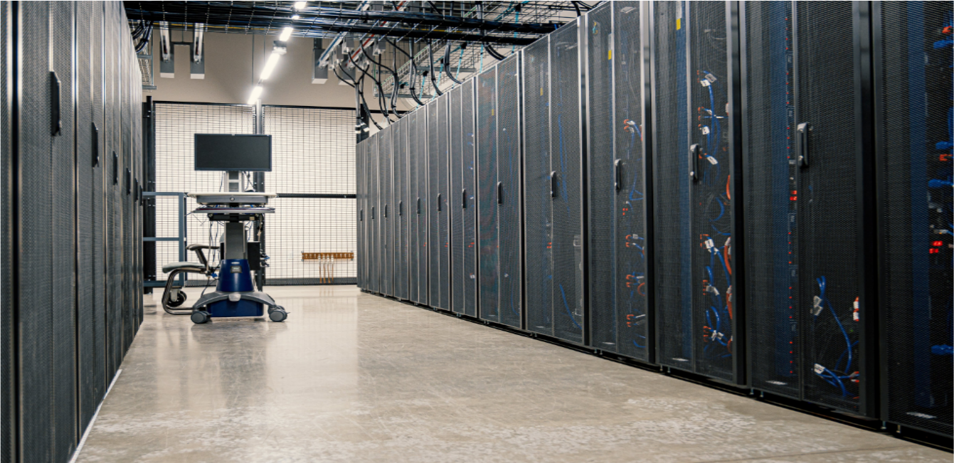


goal
The intention of this project is to implement a virtual private cloud. We will be using CloudStack on Google Cloud with Ubuntu and CentOS virtual machines.

Slide 4
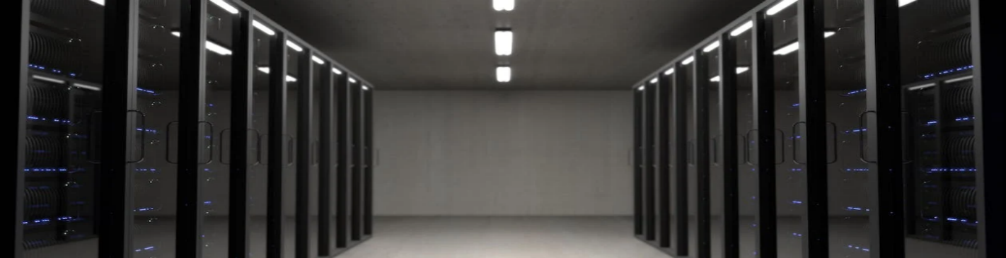
Advantages of a vpc
Summary
Scalablity and Flexibility
Isolation and Security
Customization and Control
Compliance and Governance
High Availability

Slide 5




Cost
Complexity
Compliance and legal concerns
DISADVANTAGES OF A VPC

Slide 6



Components of a Virtual private Cloud
Apache CloudStack states that a VPC is comprised of the following components:
VPC: A VPC acts as a container for multiple isolated Networks that can communicate with each other via its virtual router.
Network Tiers: Each Network Tier acts as an isolated Network with its own VLANs and CIDR list, where you can place groups of resources, such as Instances. The Network Tiers are segmented by means of VLANs. The NIC of each Network Tier acts as its gateway.
Virtual Router: A virtual router is automatically created and started when you create a VPC. The virtual router connect the Network Tiers and direct traffic among the public gateway, the VPN gateways, and the NAT Instances. For each Network Tier, a corresponding NIC and IP exist in the virtual router. The virtual router provides DNS and DHCP services through its IP.
Public Gateway: The traffic to and from the Internet routed to the VPC through the public gateway. In a VPC, the public gateway is not exposed to the end user; therefore, static routes are not support for the public gateway.
Private Gateway: All the traffic to and from a private Network routed to the VPC through the private gateway.
VPN Gateway: The VPC side of a VPN connection.
Site-to-Site VPN Connection: A hardware-based VPN connection between your VPC and your datacenter, home Network, or co-location facility.
Customer Gateway: The customer side of a VPN Connection.
NAT Instance: An Instance that provides Port Address Translation for Instances to access the Internet via the public gateway.
Network ACL: Network ACL is a group of Network ACL items. Network ACL items are nothing but numbered rules that are evaluated in order, starting with the lowest numbered rule. These rules determine whether traffic is allowed in or out of any Network Tier associated with the Network ACL.
(Apache CloudStack n.d.)

Slide 7
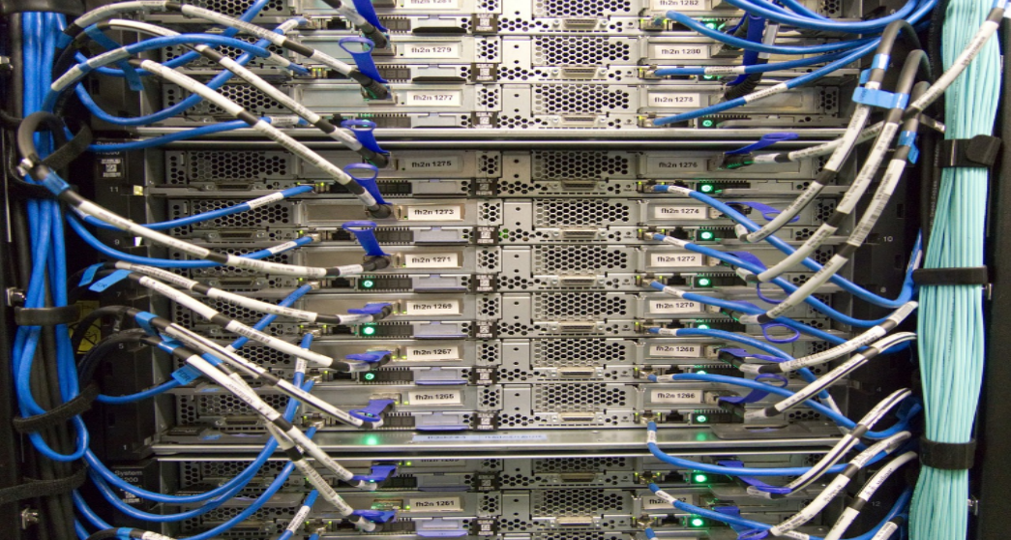
Network architecture
configurations
connectivity
Public gateway only
Public and private gateways
Public and private gateways and VPNs
Private gateway only and VPNs
Through the internet using a public gateway.
Using a site-to-site VPN through a public gateway.
Both options can be used simultaneously.

Slide 8
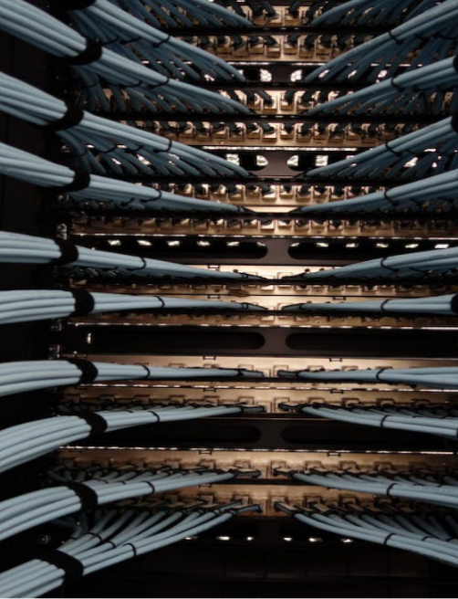
Configuration
Advanced Zone Physical Network Configuration
Adding a Virtual Private Cloud
Adding Network Tiers
Deploying Instances to the Tier
Acquiring a New IP Address for a VPC
Releasing an IP Address Allotted to a VPC
Enabling or Disabling Static NAT on a VPC
Removing Tiers
Editing, Restarting, and Removing a Virtual Private Cloud

Slide 9

Processes that worked
Management Server Configuration
Storage Configuration
Zone, Pod, Cluster, Host, Primary and Secondary Storage Configuration

Slide 10

Processes that did not work
IP Addressing
Virtual Routing
Trouble with deleting configurations

Slide 11
Summary
There are many facets of a VPC that can be beneficial to organizations that are contemplating moving their computing infrastructure to the cloud. CloudStack can be configured to have many virtual private networks to serve customers who need the highest level of security for their cloud computing resources. This can be accomplished in a relatively short amount of time with basic knowledge of the CloudStack application.

Slide 12

Thank you
Dustin Mcclure
Jonathan Korstad
Mathew Moklebust
Nekoashi Wolf

